Slide 1

Java Time! Weekly Planner
A Road Map of My Development Cycle
Yoko Parks

Slide 2
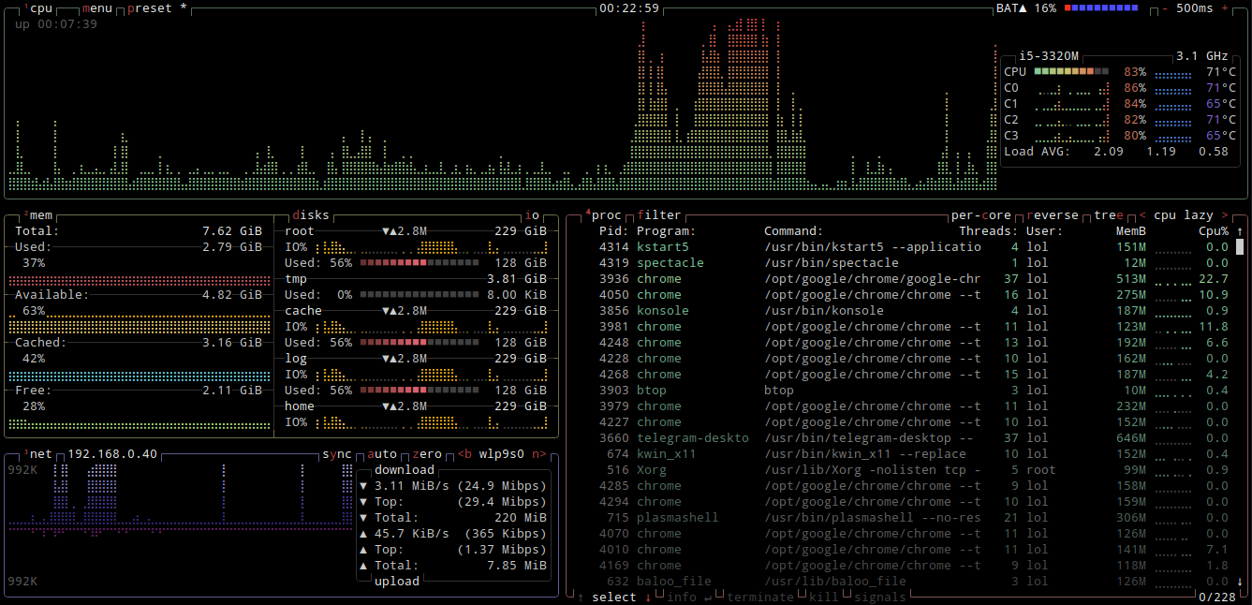
The Idea
I wanted to create a week at a glance planner without the distractions of Google or The Internet. This idea resonated with me due to my ADHD tendencies.
I also wanted to bring some Bash/DOS designs to my program to pay homage.
I wanted to do something new rather than adding onto an old program
BTOP: A Unix Terminal Task-Manager

Slide 3
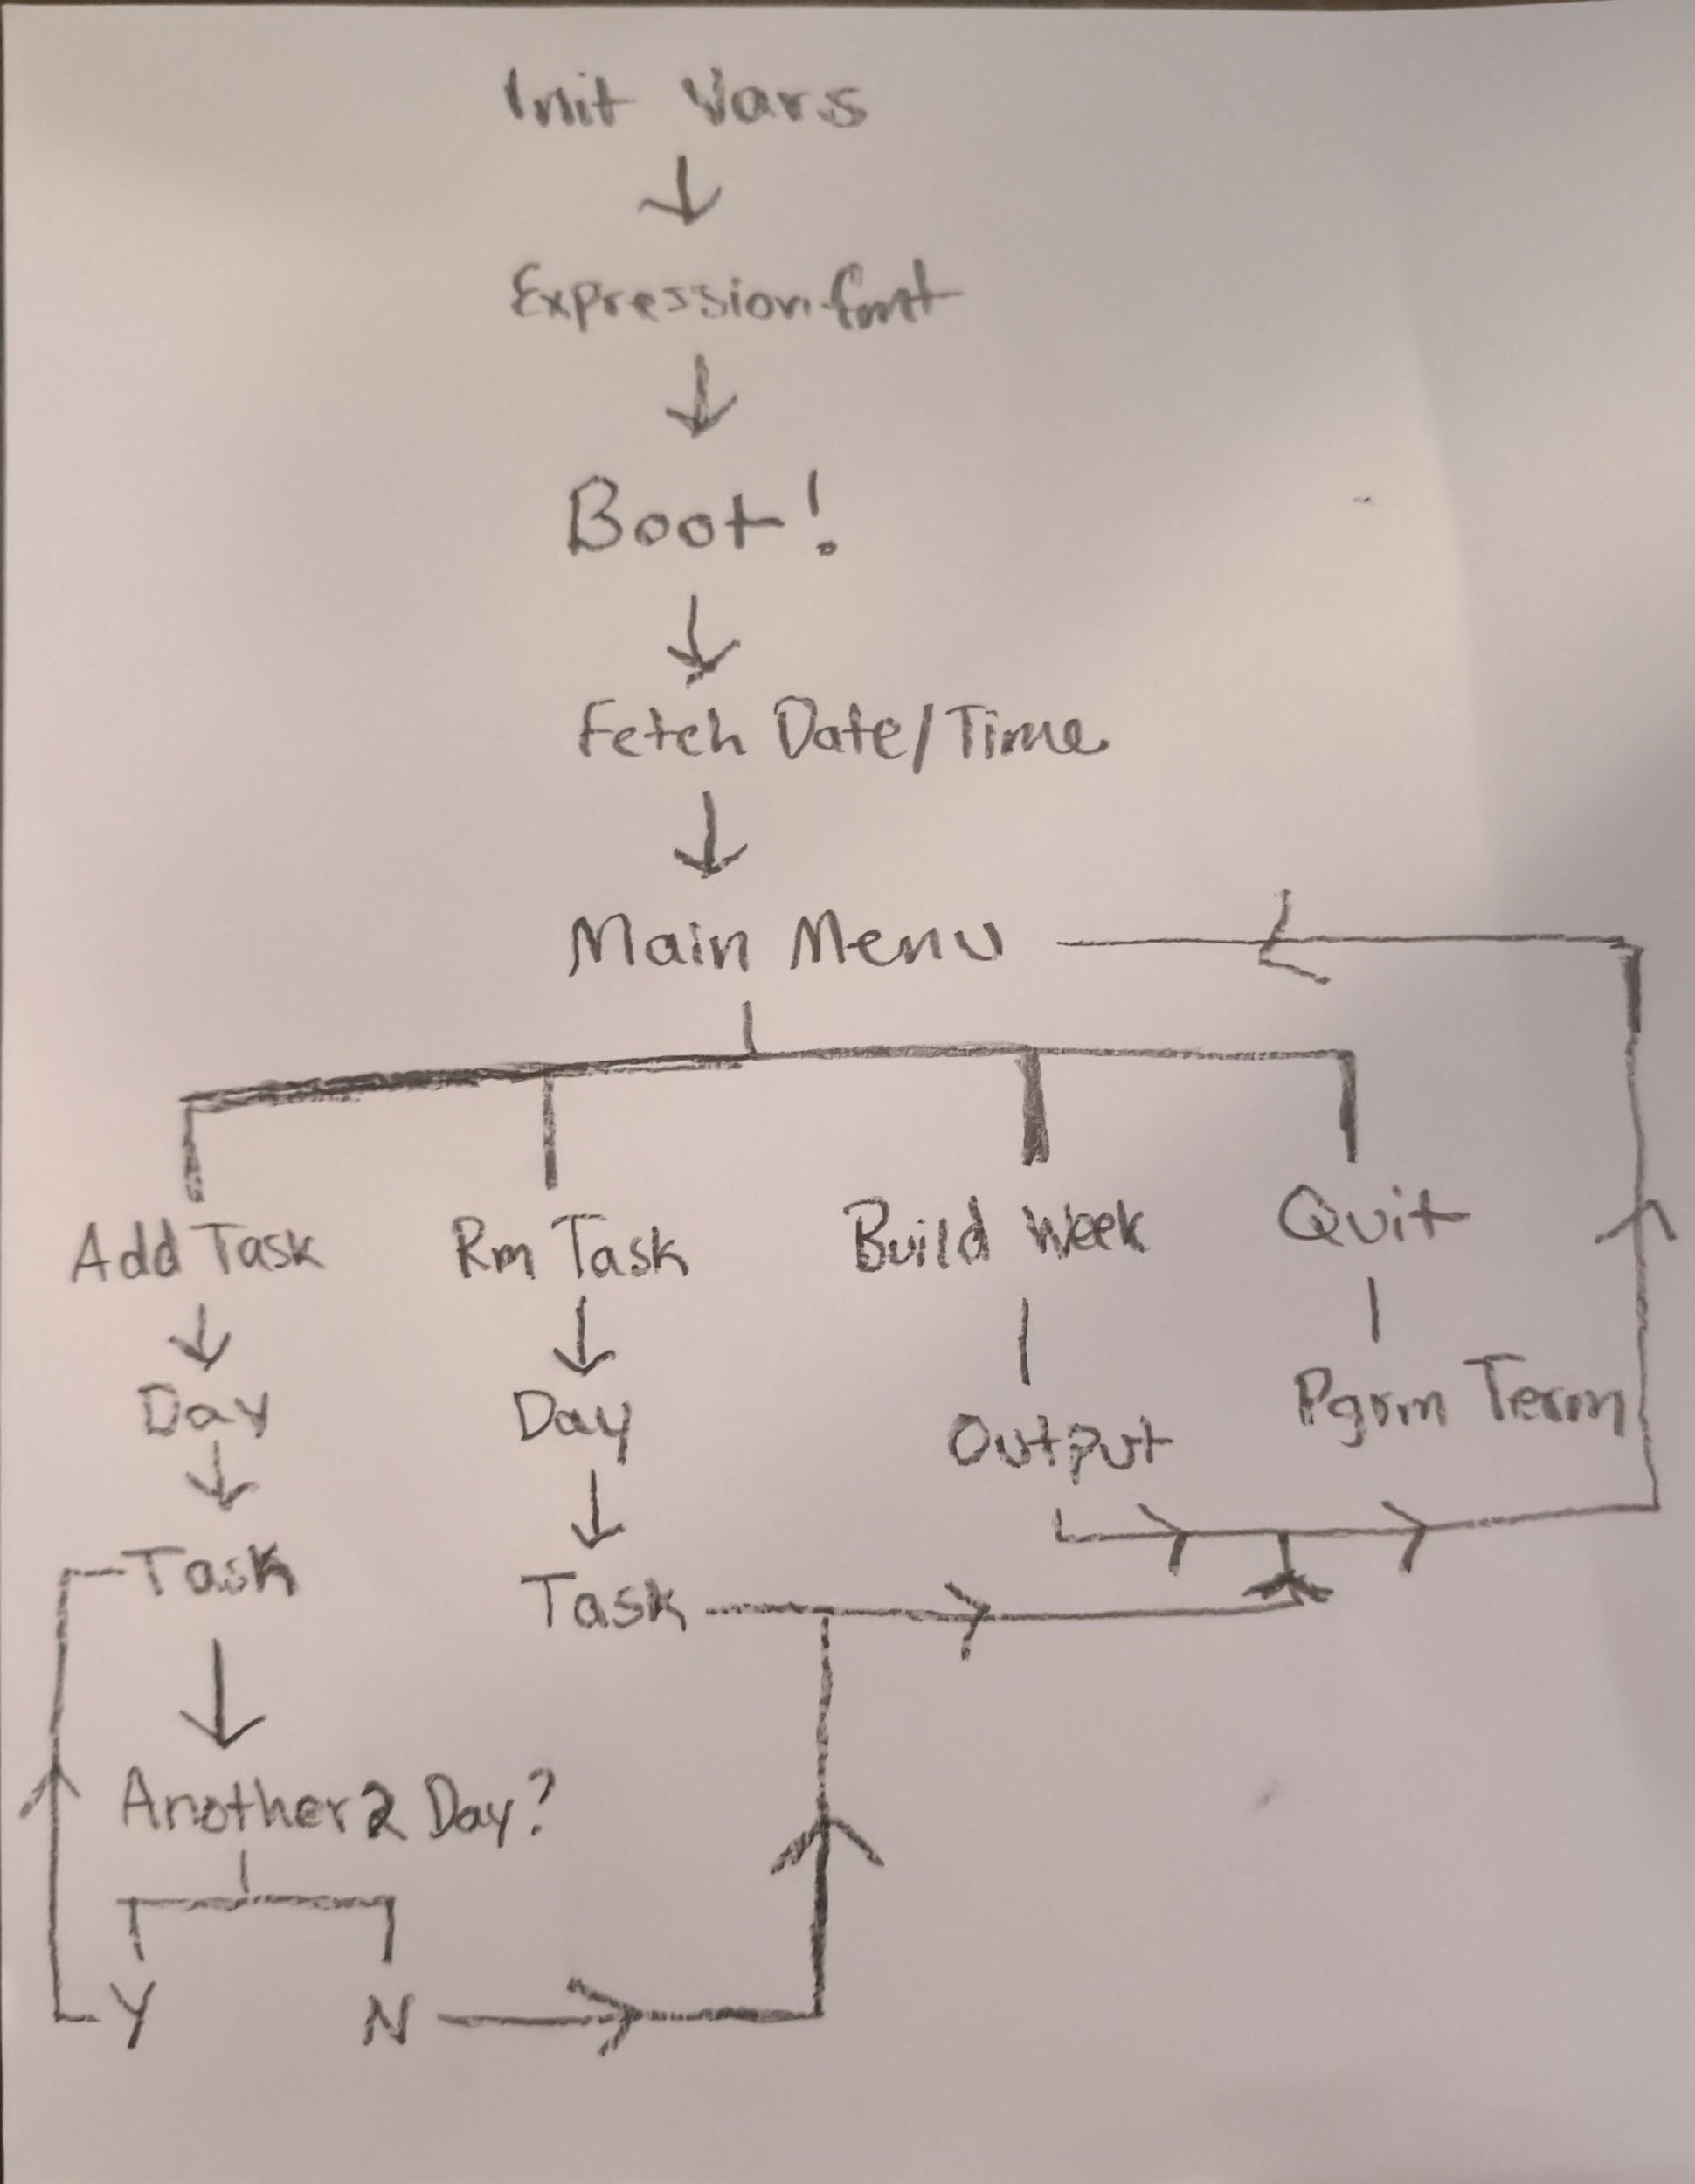
General Structure
Attached is a flow chart of how the program is supposed to work
This is a basic overview and doesn’t include my error handling functions
Helped me direct my focus towards my vision

Slide 4
Debugging The Program
I did my debugging by doing passes through each function as it was implemented
Had the advantage of moving quicker to roll out changes but made each code change very messy and super different
I have included snapshots of raw code at different times, if you want a full view perhaps not captured by the buggy file please look
Certain Implementation ideas do not persist through the file versions as they were replaced with better algorithms
I used a focus group of 3 people to help me make the UI easy to use

Slide 5
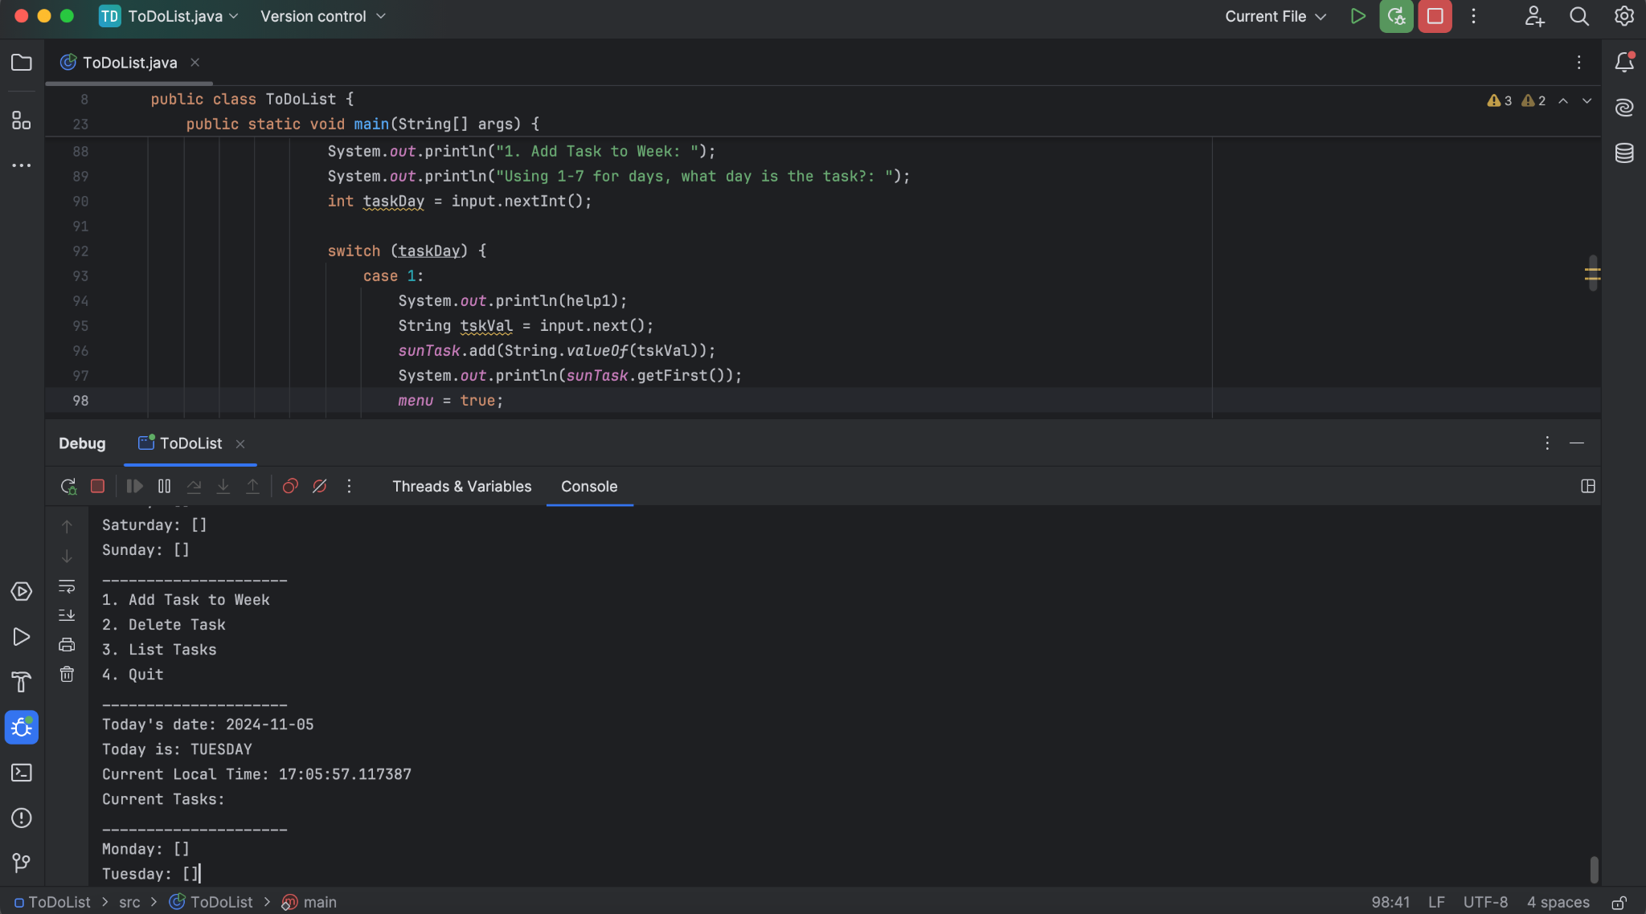
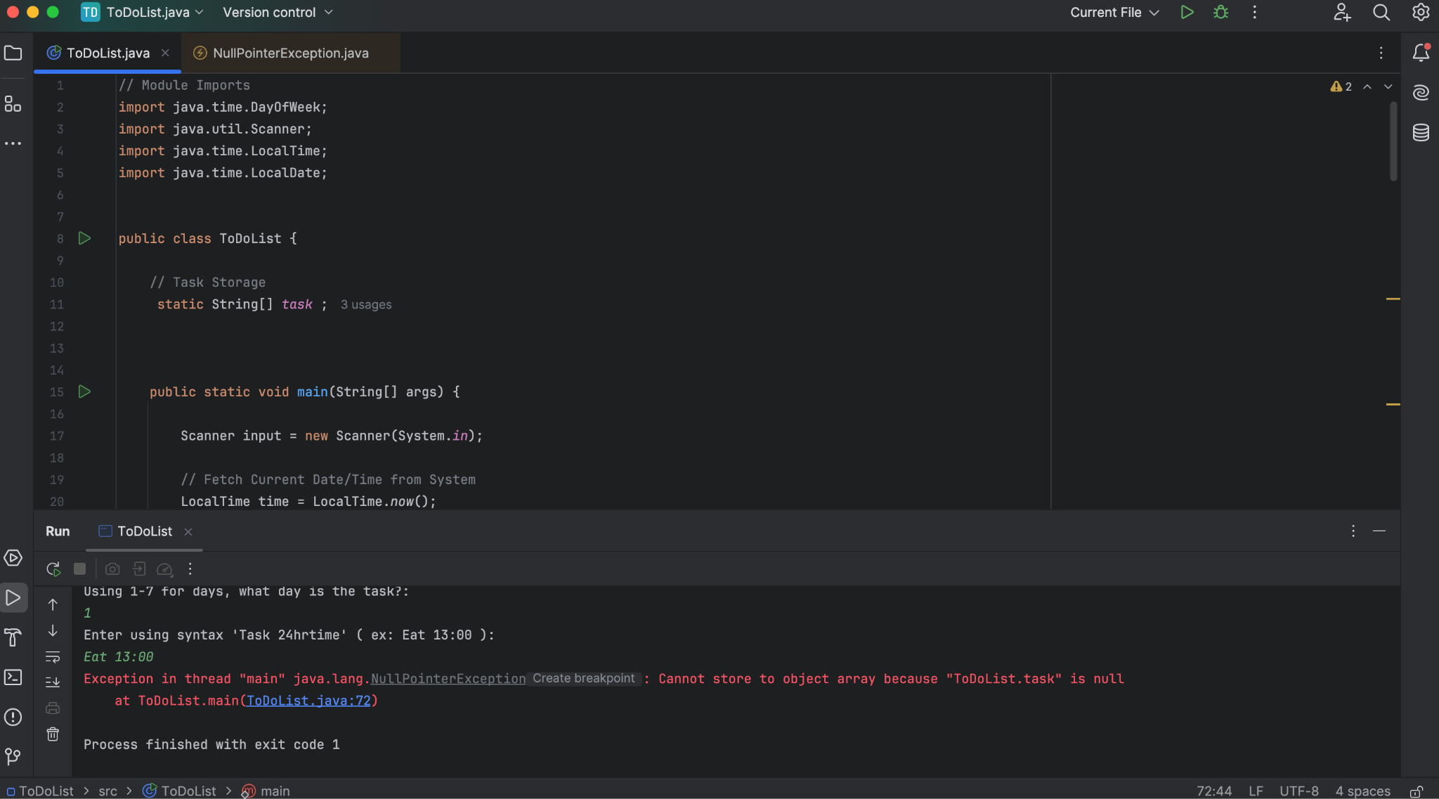
Bug Hall of Fame
Endless BootLoop (Logic)
Add Task Thread Except (Runtime)

Slide 6
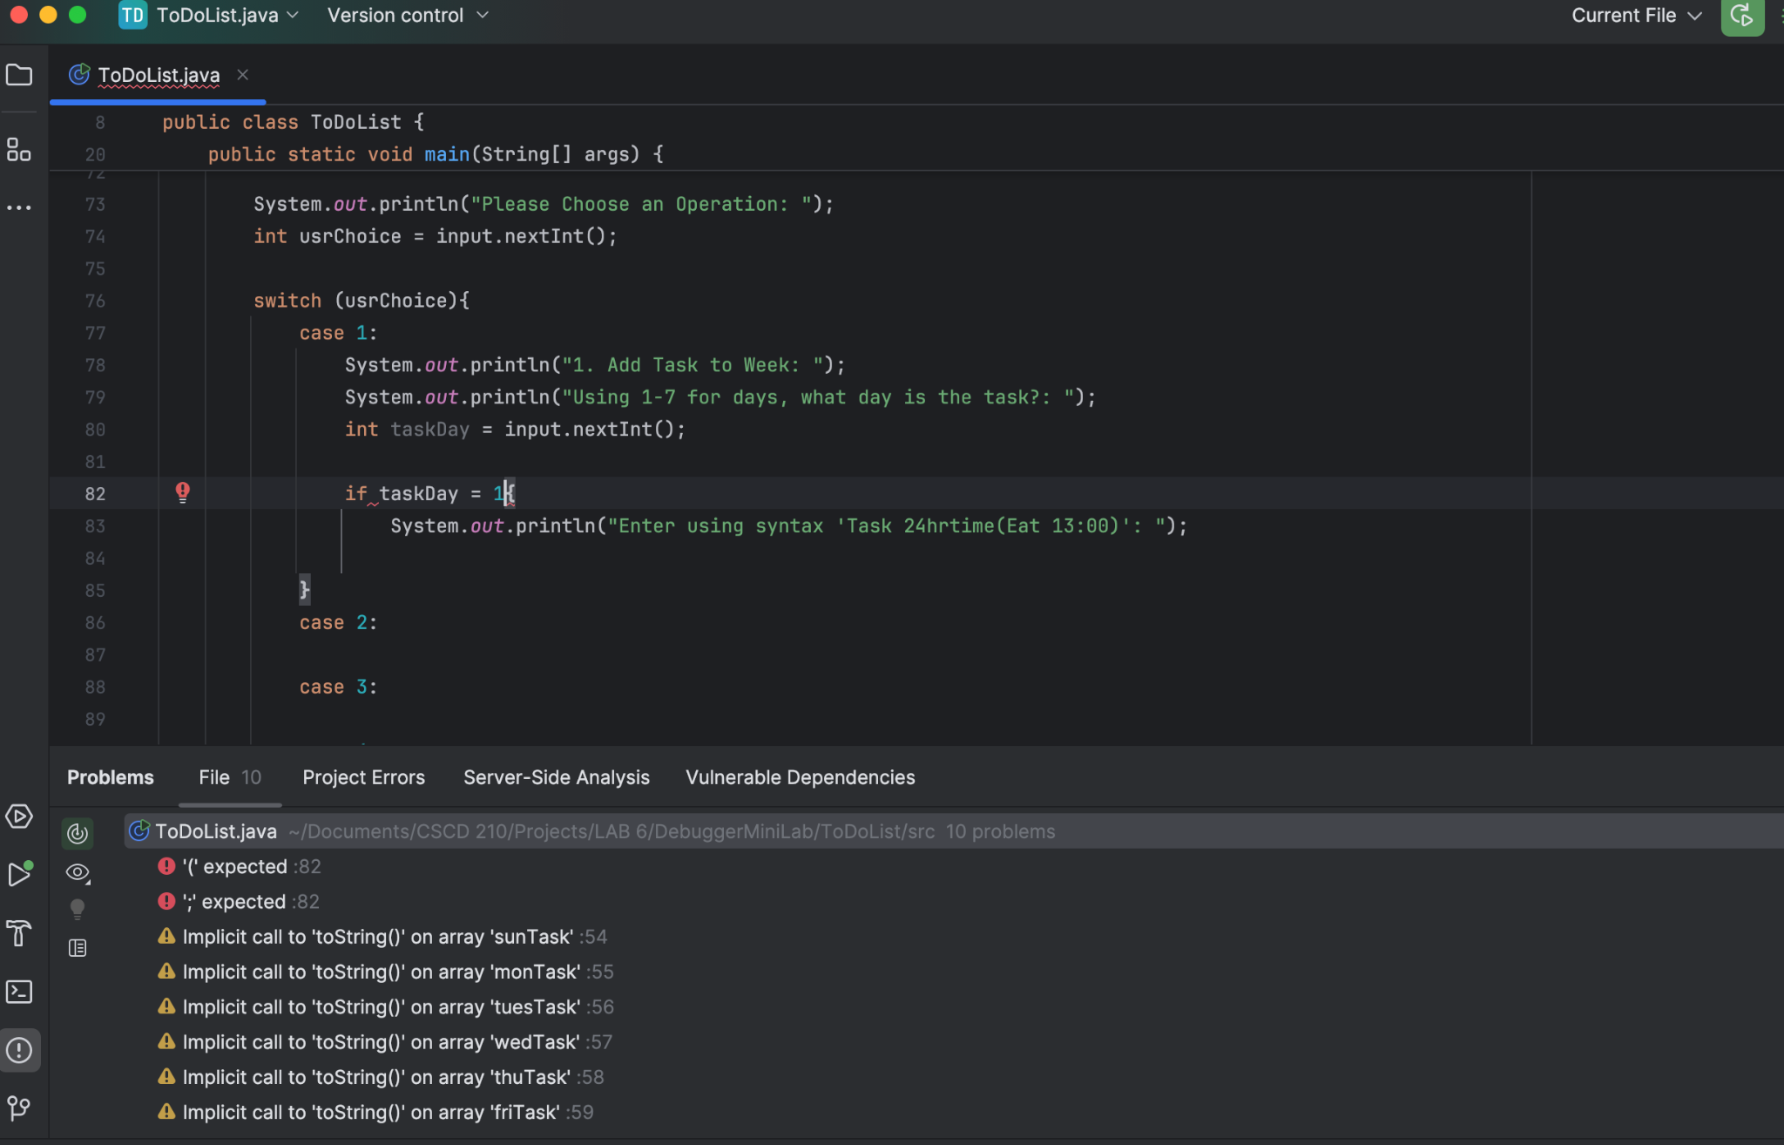
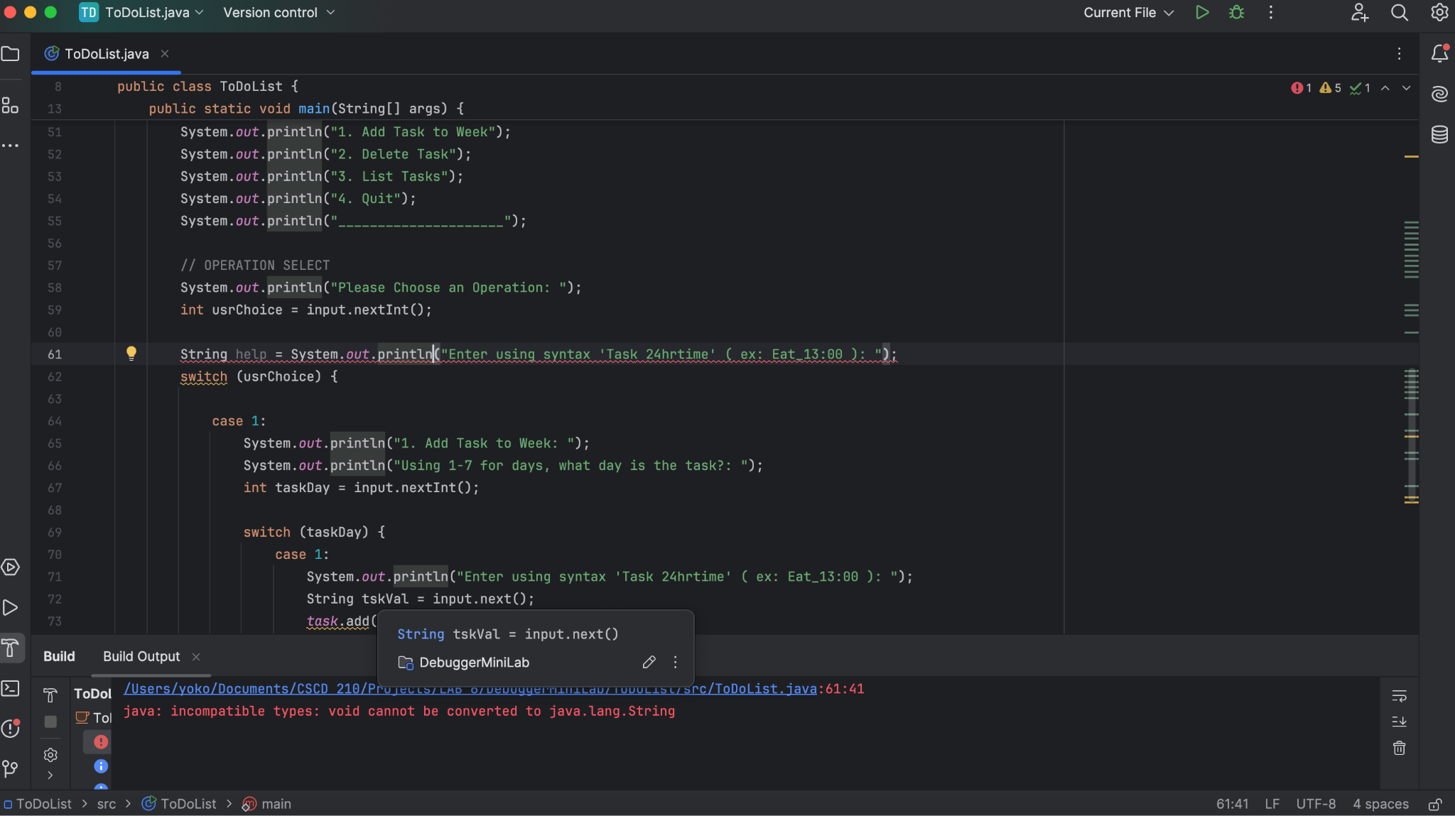
Bug Hall of Fame
Err L82 (Syntax)
Err L61 (Syntax)

Slide 7
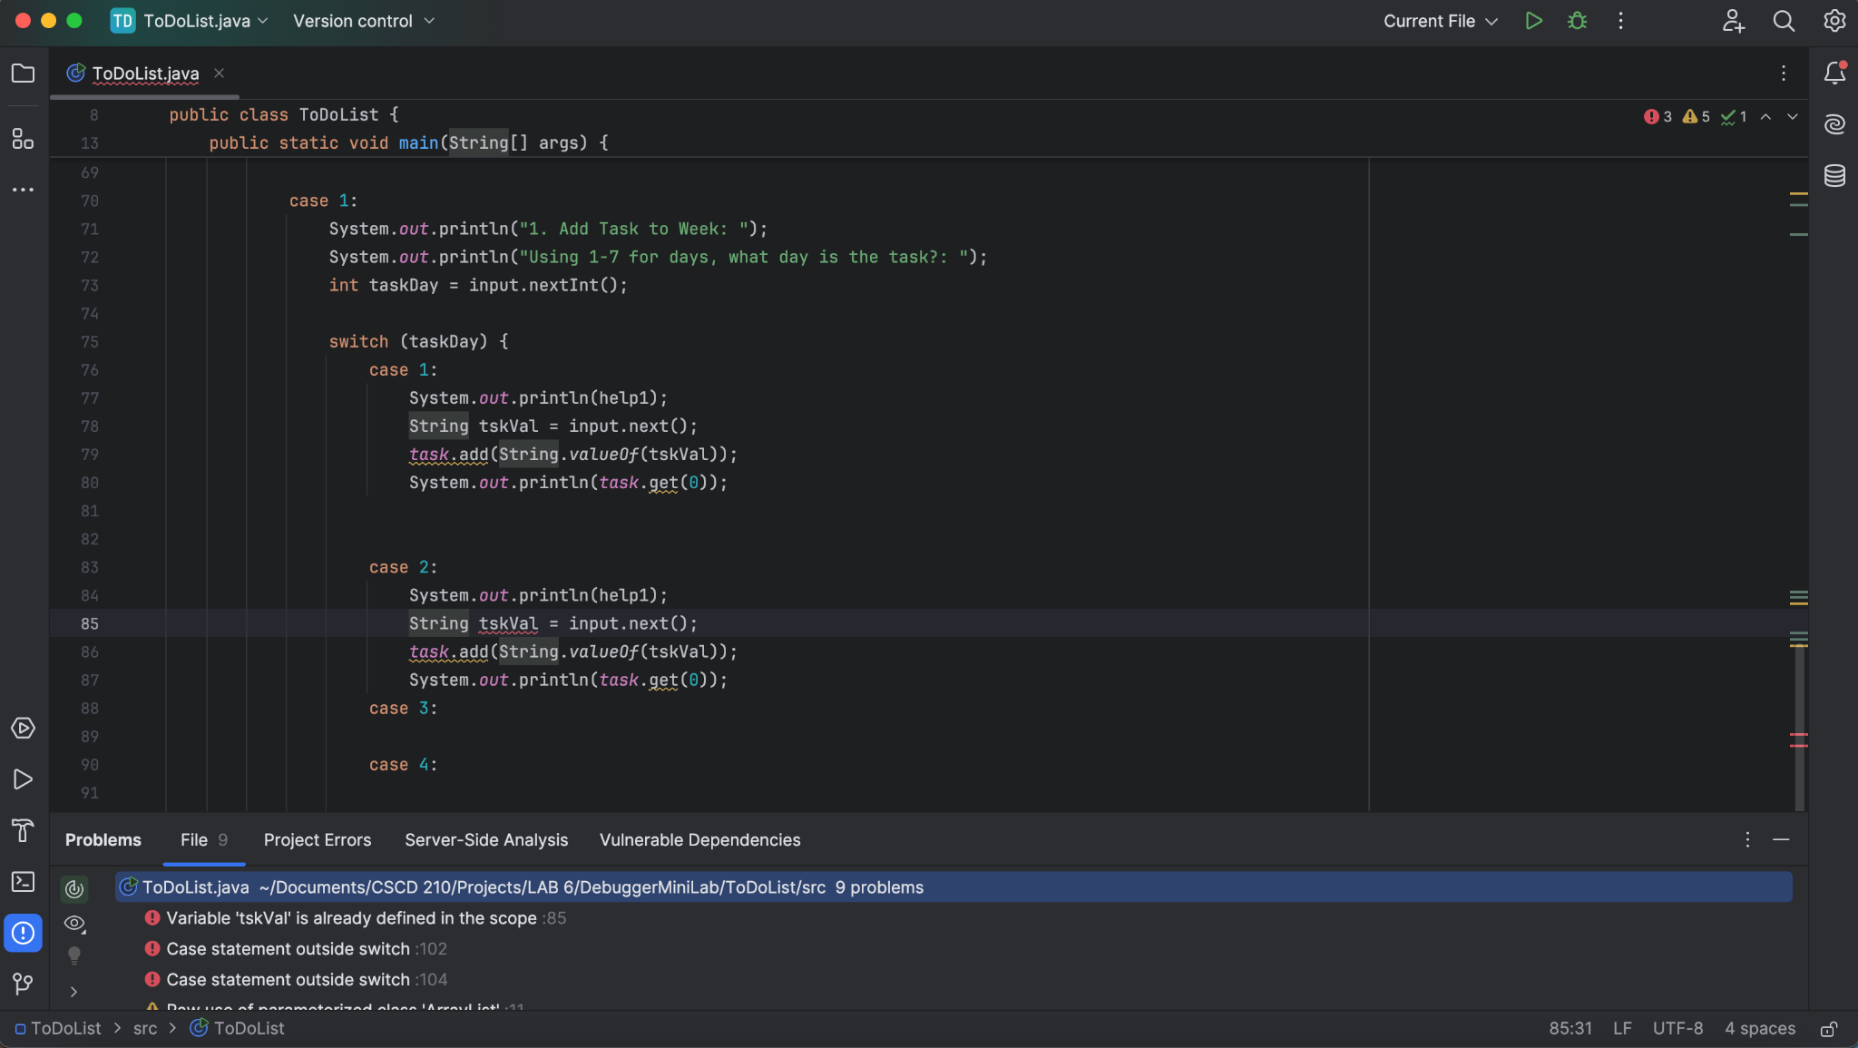
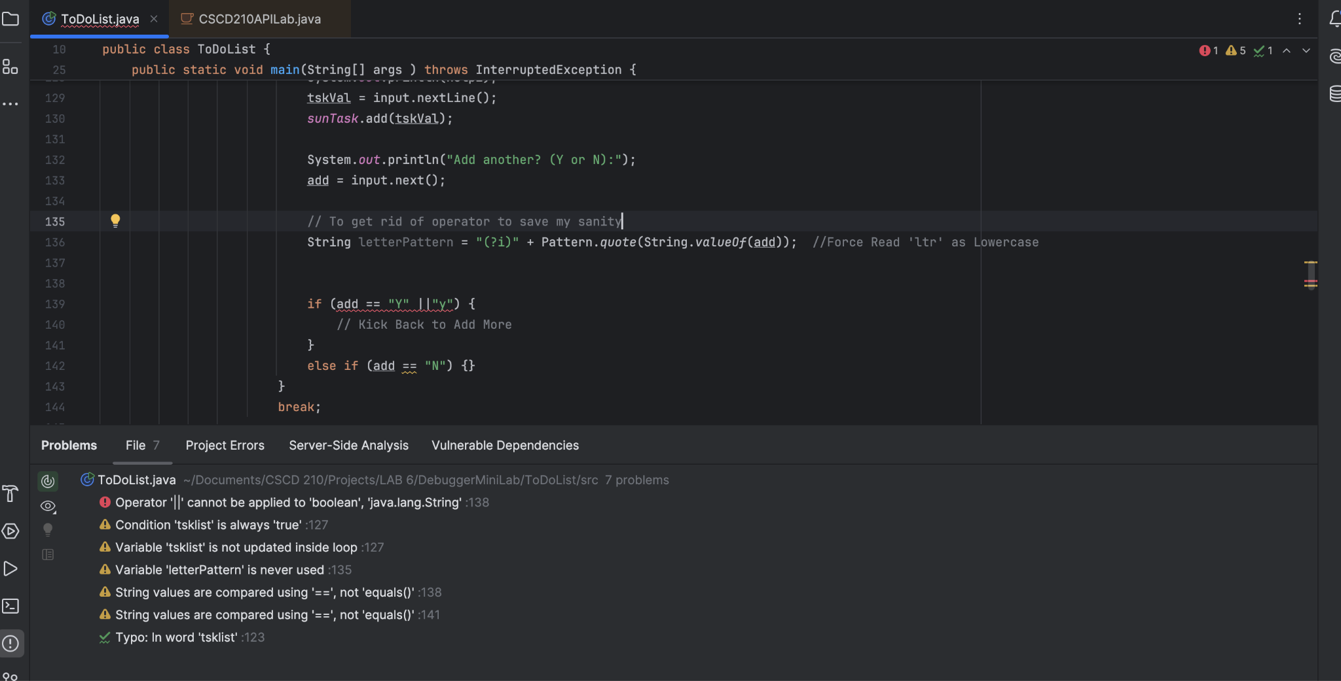
Bug Hall of Fame
Err L85 (Syntax)
Err L138 (Syntax)

Slide 8
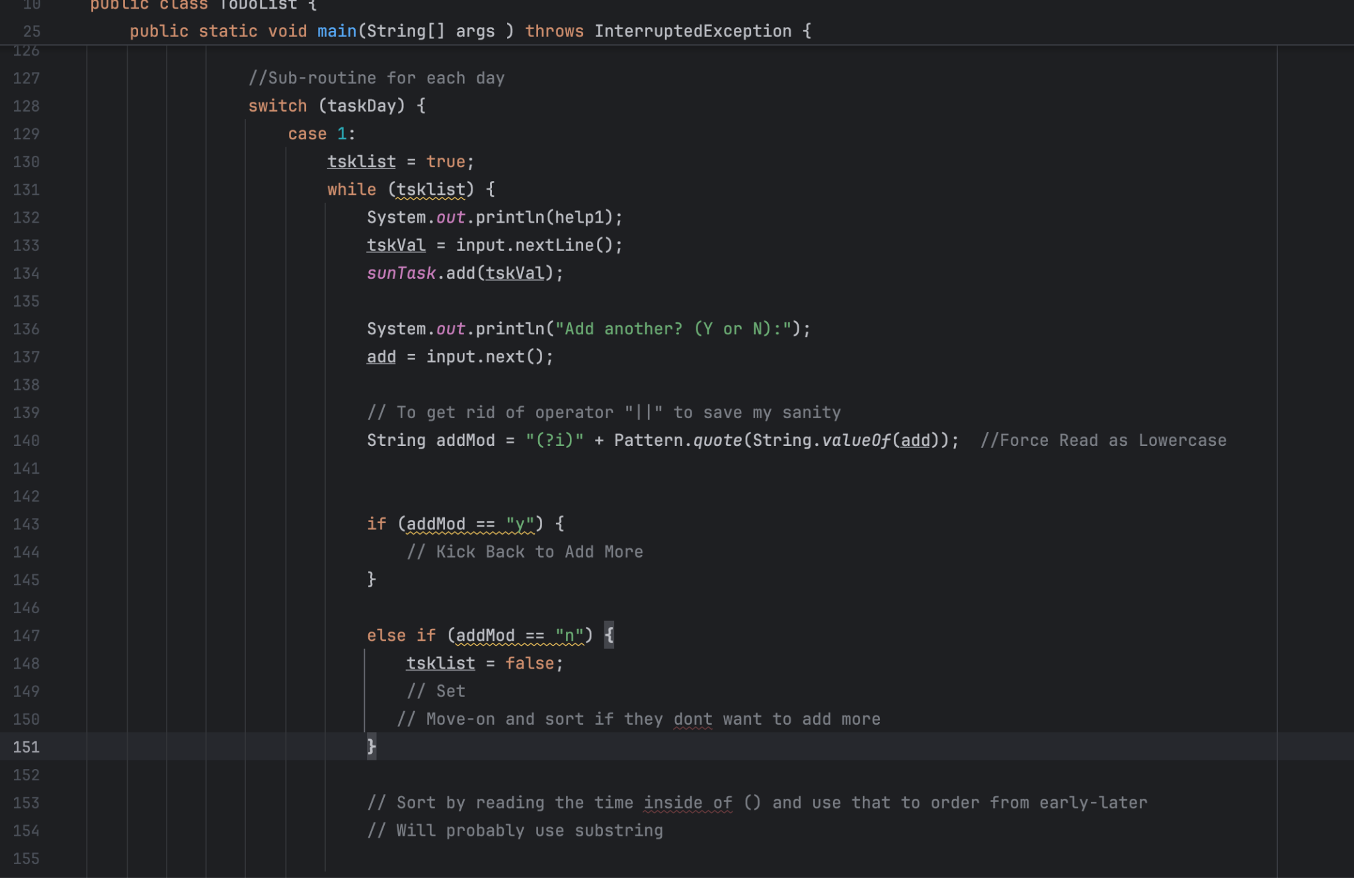
Bug Hall of Fame
Add More Task? (Logic)

Slide 9
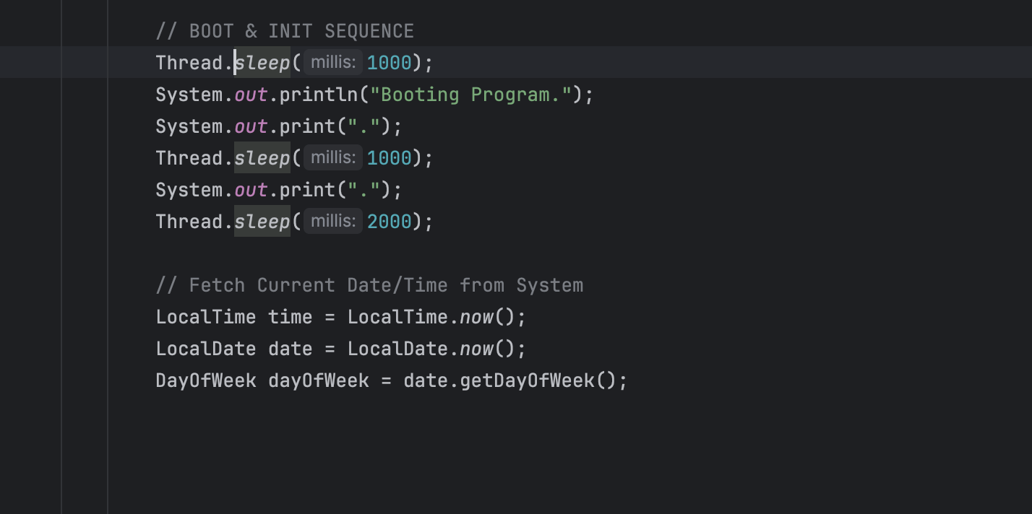
Bug Hall of Fame
Boot Animation (Logic)

Slide 10
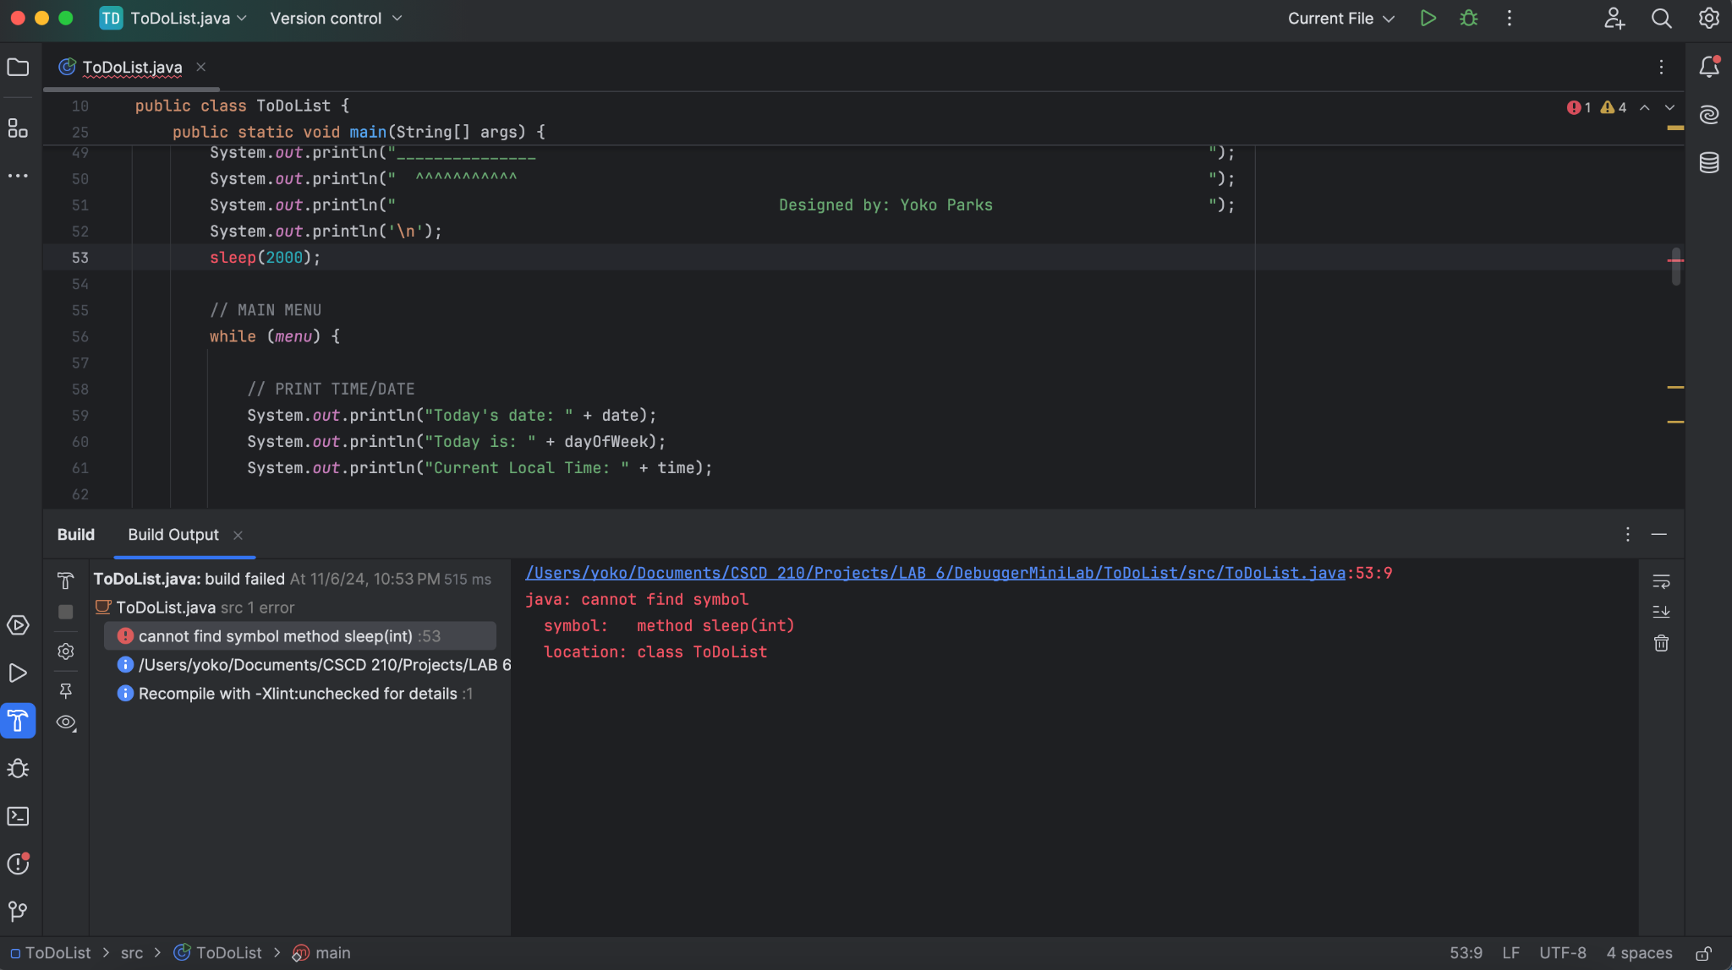
Bug Hall of Fame
More Animation Errors (Syntax)

Slide 11
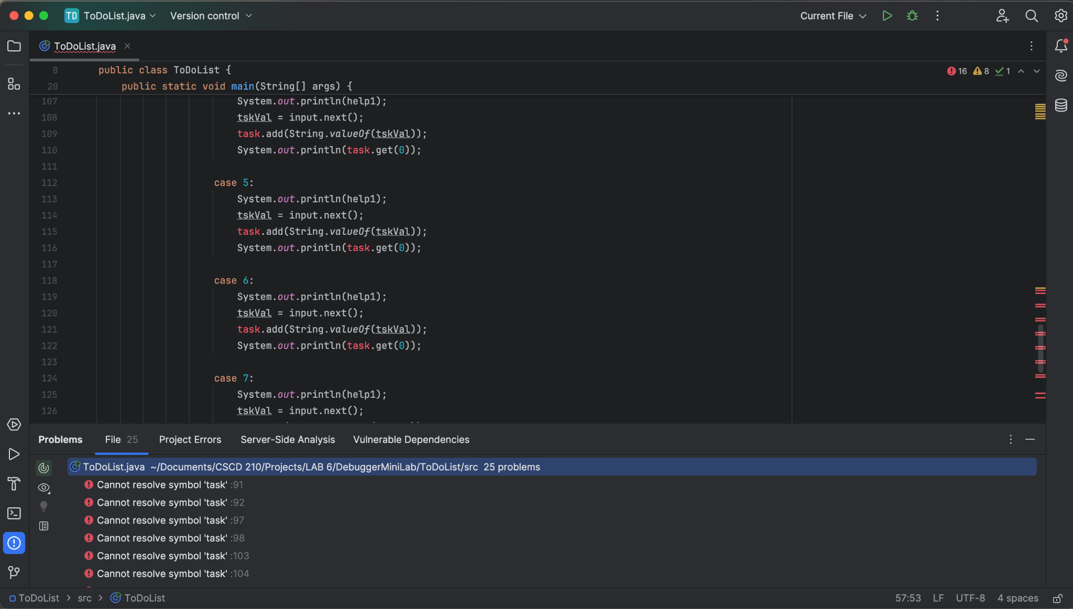
King of The Bugs
Task Var Resolution (Syntax bc I removed a single reference upstream)

Slide 12
General Challenges
Organization of my thoughts in a big program; I fix bugs on the fly as opposed to writing then correcting
Constant Traversing of Code for fixes
Boot Animation without libraries
Scope of the project may have needed fleshing out
Time Constraint
Syntax & Logic Errors galore compared to Runtime Errors

Slide 13
Overcoming Obstacles
Animated sequences using print appends and sleep functions
Debugging Console being a timesaver
Getting creative to work around issues with structure & design
Breaking down problems into their parts
Copying code to keep track of progress
Scheduling to carve out time

Slide 14
Program Limitations
Only schedules 1 week at a time right now, and has no scheduling intelligence (yet)
Error handling has remained extremely sensitive, while most of them are patched I still have extreme edge cases to implement
Heavy Reliance on “if” statements and switches
UI animation is hard-coded and makes the code unfriendly to human eyes
Planned Features needing extreme work to implement
Unorthodox Organization of Code

Slide 15

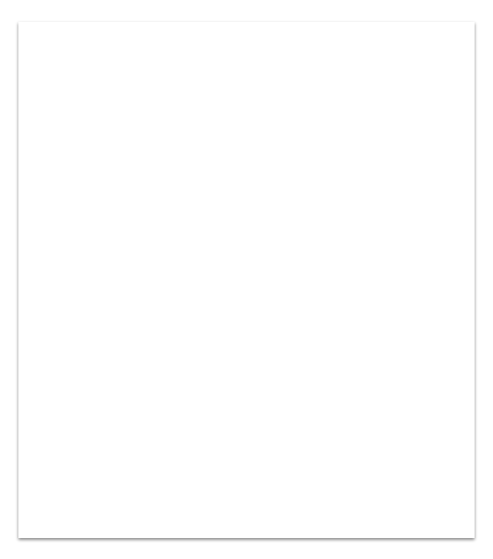
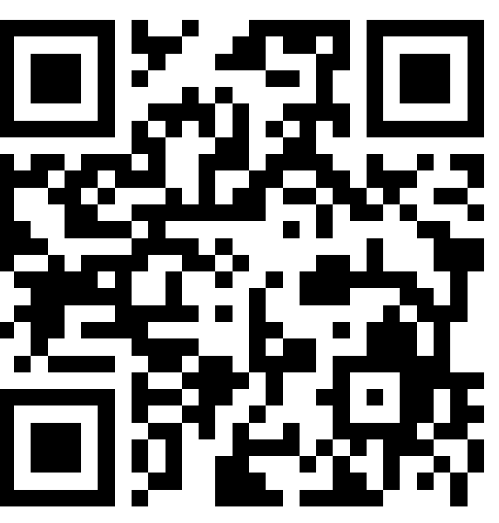
Thank You!
This project was not only one for an assignment, but also for a skill display on my github page. If you’re interested in following my work; please find me on GitHub via the QR. All projects are made and graded before being posted there to ensure academic integrity.

